Slide 1
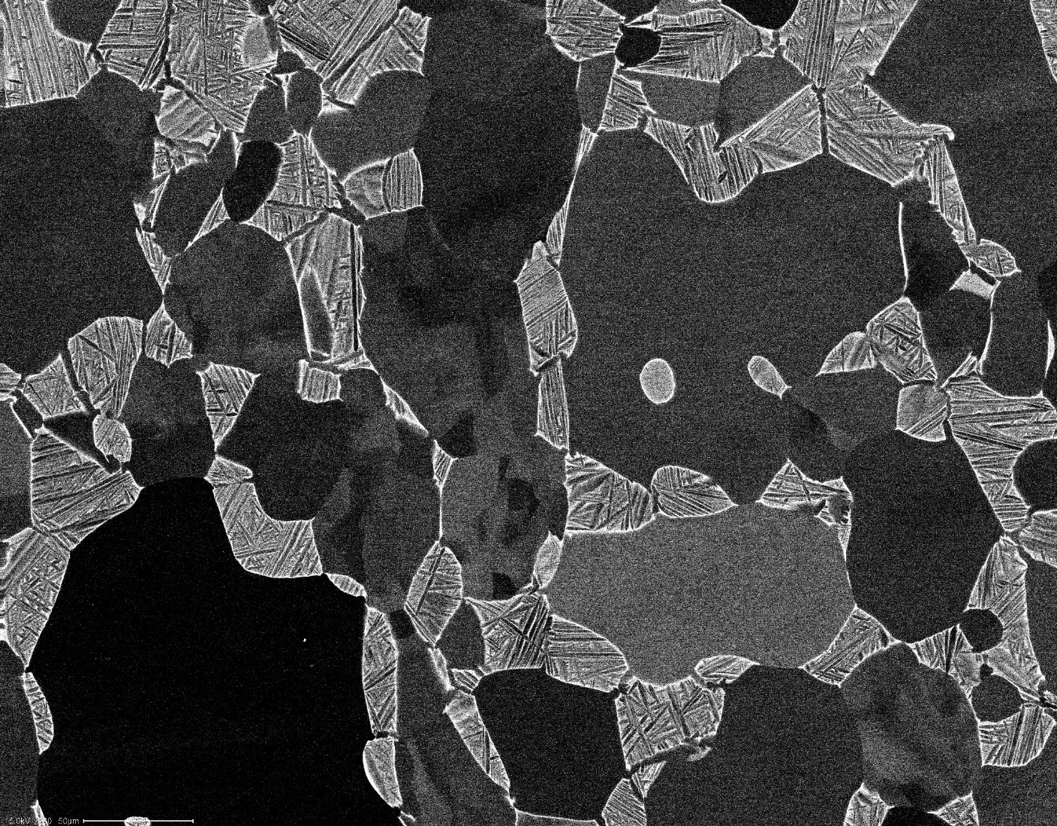
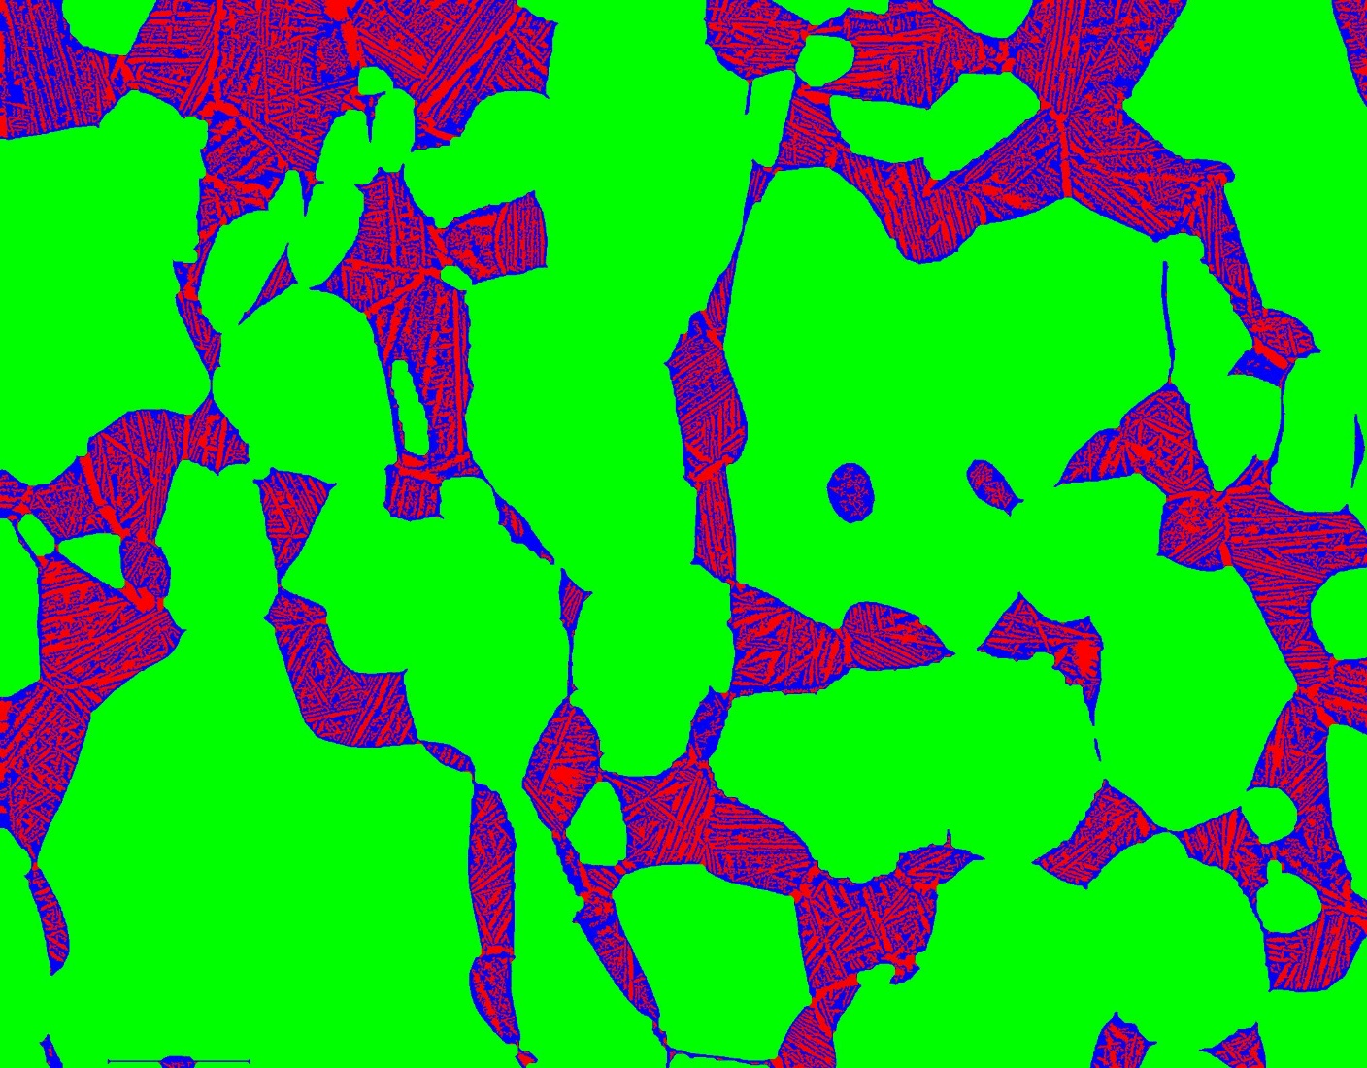

Slide 2
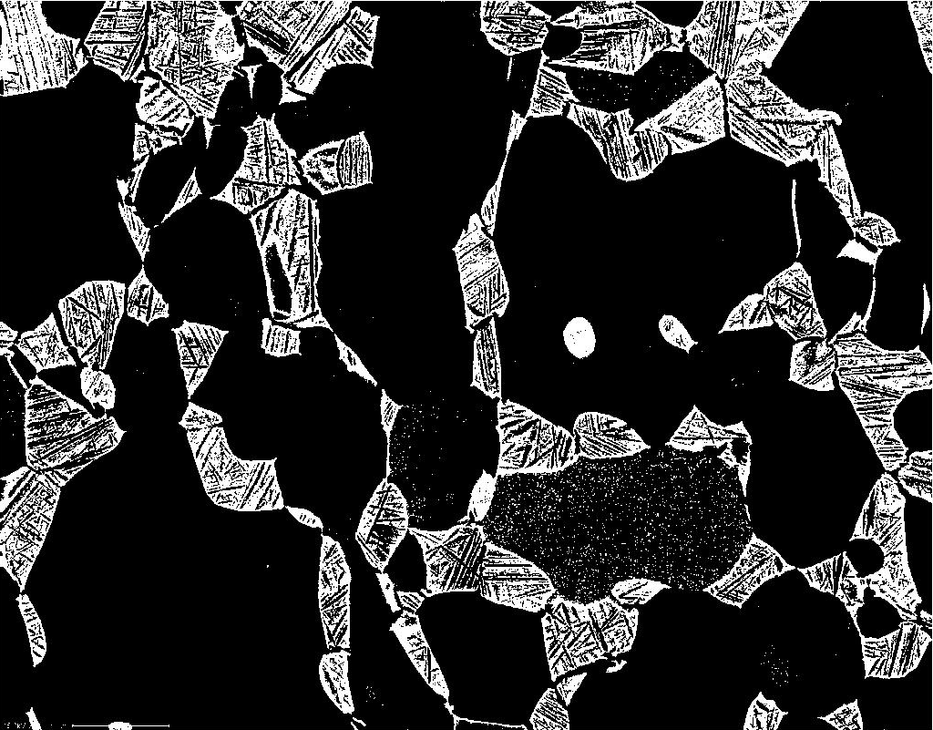
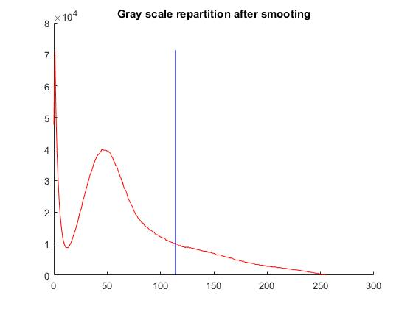

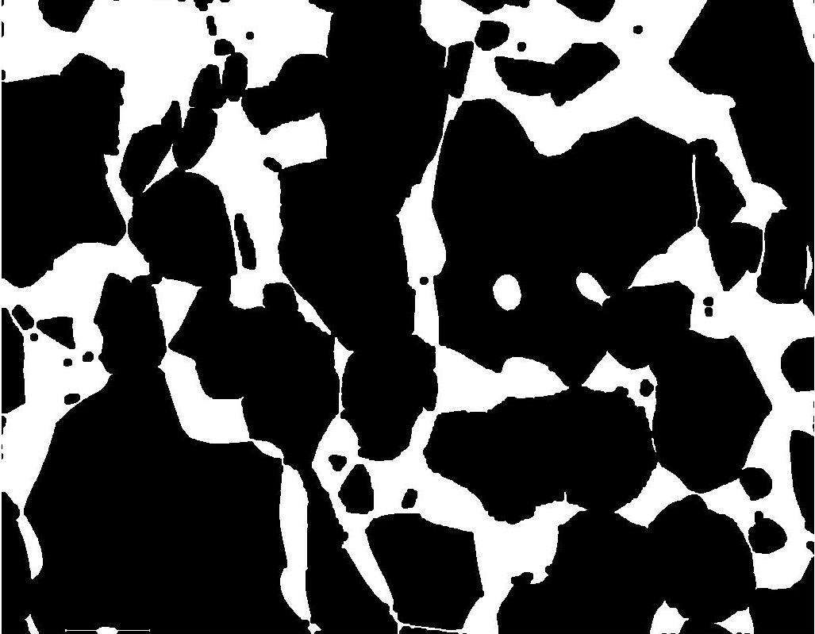
clear; close all;
fname=('950C5hAC_800x');
i = imread(sprintf('%s.tif',fname));
[h, w] = size(i);
%% Gaussian smoothing & manual threshold
a = imgaussfilt(i,1);
t=114;
A = a>t;
%% Remove small white dot (150 px)
objSize = 50 ;
B = bwareaopen(A,objSize);
%% Filling the black lamellae of secondary α
C = imclose(B,strel('disk',10));
%% Close the white grain (remove dark dot)
objSize = 1600 ;
D = ~bwareaopen(~C,objSize);

Slide 3

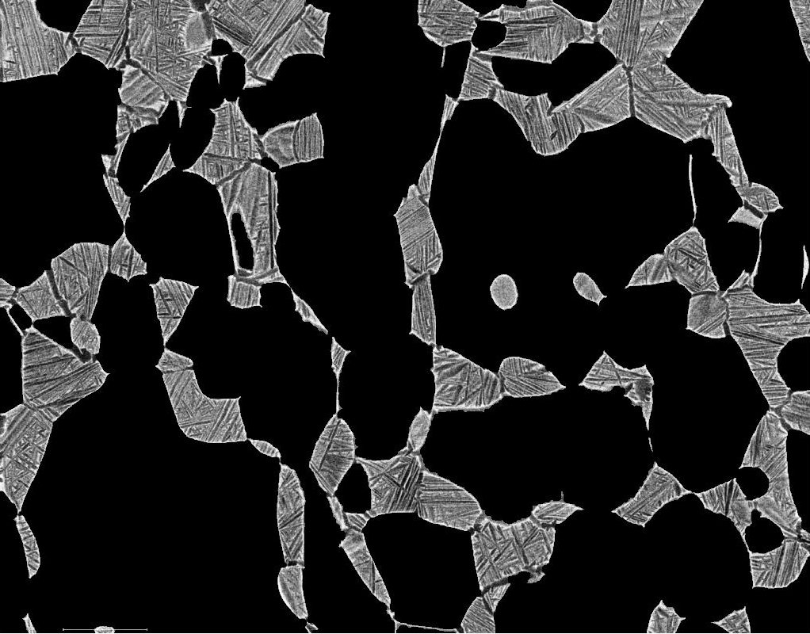

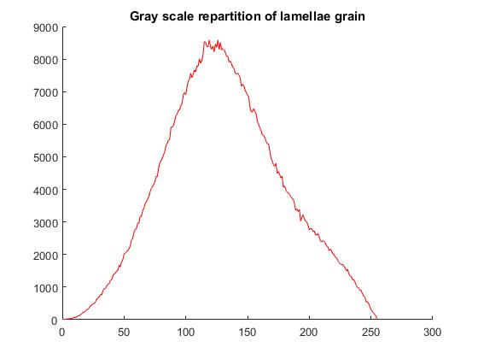
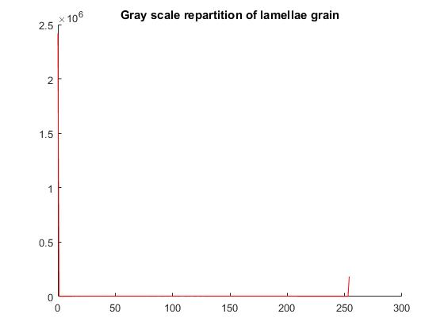
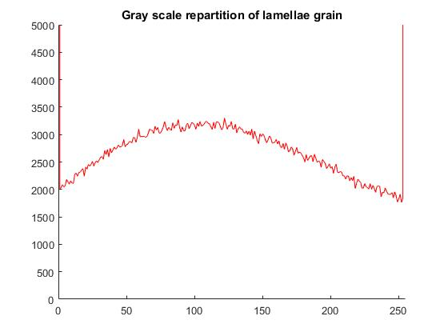
[D]
%% alpha phase is given the 0 value
idx = find(D == 0); % idx = index of α phase
a(idx) = 0;
%% Sharpening of the β and α2 phase
amount=8;
Sa = imsharpen(a,'amount',amount);

Slide 4
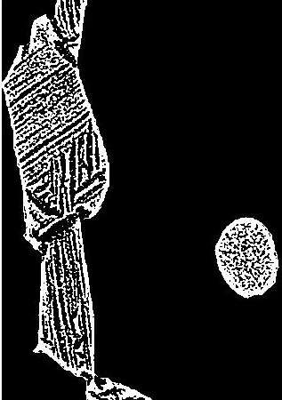
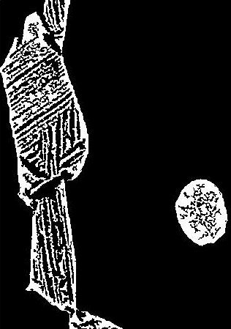
%% Masking of alpha phase (NaN)
Sa_NaN=double(Sa);
Sa_NaN(idx)=NaN;
% threshold on remaining β and α2
Sa_nonans=Sa_NaN(~isnan(Sa_NaN(:)));
counts = grscrep(Sa_nonans,size(Sa_nonans),1);
t = otsuthresh(counts(2,:))*255;
Salpha1 = D==0;
Salpha2 = Sa_NaN<=t;
Sbeta = Sa_NaN>t;
%% Remove small α2 and β dot
SbetaN = ~bwareaopen(~Sbeta,20);
SbetaN = bwareaopen(SbetaN,20);
% delete alpha 2 that are now beta
Salpha2N = ~(Salpha1 + SbetaN );
%% Save three phases as a tiff file
SFinalSegN =zeros(h,w,3);
SFinalSegN(:,:,1)=Salpha2N;
SFinalSegN(:,:,2)=Salpha1;
SFinalSegN(:,:,3)=SbetaN;
imwrite(SFinalSegN,sprintf('%s_Segmented(shap8)_NoNaNs.tif',fname));

Slide 5

Volume fraction (%)
α | 70.6
β | 15.17
α2 | 14.23

